Slide 1
moose for dcs world in 5 minutes

Slide 2
Challenges for a dcs world mission designer
Mission Editor of DCS
Difficult to identify the problem
Hard to follow the workflow. Logic spread out over your mission.
Limited Functionality
Change management is difficult in mission files.
Scripting: using DCS API
Learning curve of lua. The DCS API is “deep”.
Hardly any debugging facilities.
Community
Existing scripts hard to re-use. (GCICAP) fe.
No standards.

Slide 3
why don’t you try moose?
Mission Editor: Code your mission logic using the Eclipse Lua Development Tools
Workflow is embedded in one script file. No hidden code.
Also, workflow tools are embedded within MOOSE.
Develop lua using a professional lua code editor.
MOOSE provides with online documentation of ALL the classes!
Change management is now a lot easier. All your code in one file, search, replace now becomes an option. Cut-paste is easier.
Scripting: using MOOSE API
There is still a lua learning curve, but the framework comes with a pre-defined set of EXAMPLE MISSIONS!
Community: becomes shared and a team!
Code is shared, documented, standard.
Various support channels!
Community is growing.
The code you write is OBJECT ORIENTED. The functionality is right where your objects are!
The API is kept as simple as possible. The power of MOOSE is that you can COMBINE the objects to create missions!
Debugging facilities through tracing functions.

Slide 4
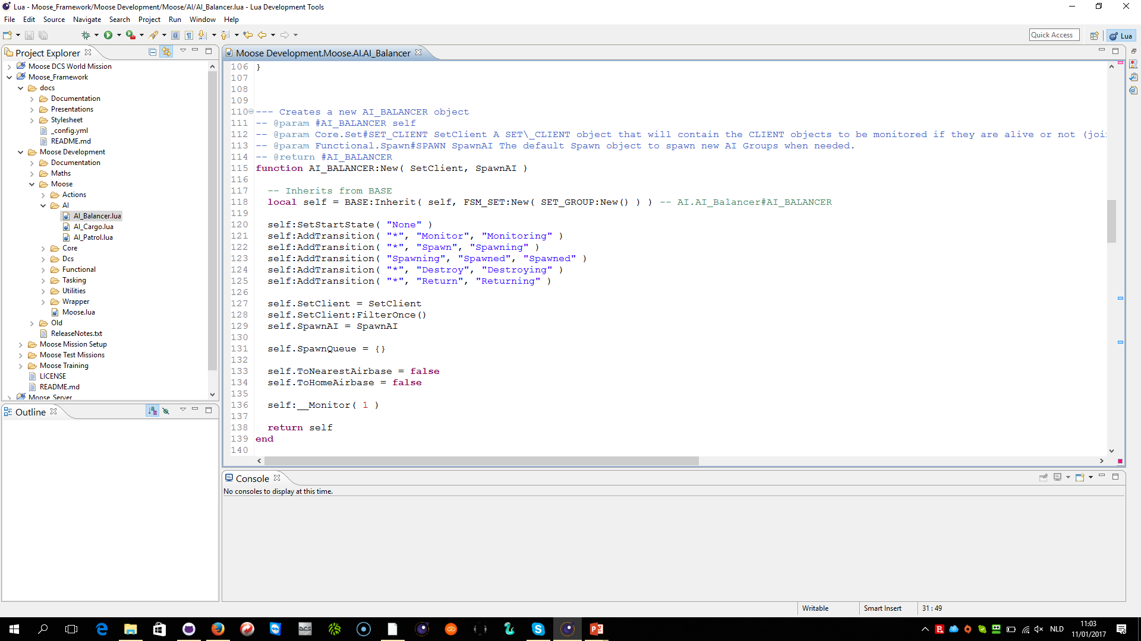
ECLIPSE ENVIRONMENT

Slide 5
MOOSE framework
FUNCTIONAL CLASSES
TASKING & MISSIONS
AI ORCHESTRATION
SPAWN
MISSILETRAINER
COMMANDCENTER
AI_BALANCER
AI_PATROL
AI_CARGO_UNIT
SEADDEFENSE
AIRBASEPOLICE
MISSION
AI_...
AI_INTERCEPT
AI_CARGO_GROUP
ESCORT
CLEANUP
TASK
TASK_SEAD, …
AI_PICKUP
AI_CARGO_SET
FOLLOW
ACT(ION)
ACT_ACCOUNT, …
AI_DEPLOY
AI_CARGO_PACKAGE
DETECTION
TASKDISPATCHER
AI_CARGO_...
MOOSE WRAPPER CLASSES
OBJECT
IDENTIFIABLE
POSITIONABLE
AIRBASE
STATIC
CONTROLLABLE
GROUP
UNIT
CLIENT
MOOSE CORE CLASSES
BASE
DATABASE
SET_BASE, SET_GROUP
SET_UNIT
SET_AIRBASE, …
EVENT
FSM, FSM_CONTROLLABLE, FSM_TASK, FSM_PROCESS, FSM_SET
ZONE_BASE, ZONE_RADIUS, ZONE_POLYGON, …
POINT_VEC2, POINT_VEC3
MENU_COALITION, MENU_GROUP
MENU_...
SCHEDULER
MESSAGE
DCS WORLD core scripting API

